Slide 1
.gif images
By Joel Johnson

Slide 2
Where did .gif images come from?
In 1987, a US-based software writer named Steve Wilhite developed the GIF image format while working for CompuServe.
Wilhite developed it for the CompuServe company who released it that same year to provide a color image format for their file downloading areas.
GIF replaced the previous RLE (Run-Length Encoding) format previously used, because it was quicker to download even on computers with slow modems
GIF stand for Graphics Interchange Format

Slide 3
What is a GIF image?
GIF is a bitmap image formate which supports up to 8 bits per pixel, which allows a single image to reference its own 256 color palette chosen from a 24-bit RGB color space.
It also supports animations and allows for up 256 colors per frame from the same 24-bit RGB palette
GIF’s are not a good format for reproducing colored photographs or high resolution images with continuous color, but is amazing for simpler images such as graphics or logos

Slide 4
Controversy:
In recent years, Steve Wilhite has come forward to explain that the pronunciation of the acronym GIF is really “JIF” and not “Ghiff”
This spawned huge controversy and arguments among the internet
I am not going to conform to this madness and I will still pronounce it “Ghiff”

Slide 5
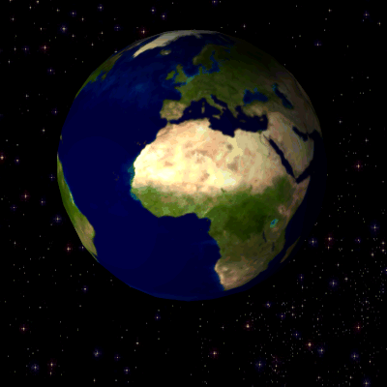
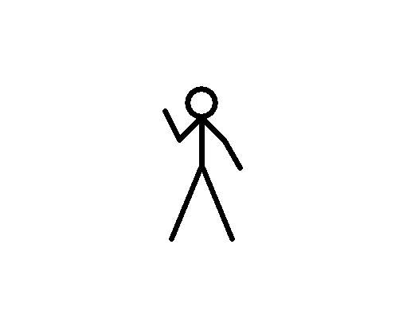
Examples:

